Slide 1











COMMIT TO THE GIT
THE IMPACT OF WALKABILITY AND PUBLIC TRANSIT ON HEALTH
An analysis of the health of citizens in areas with high walkability and accessible public transit.

Slide 2

WHY?
Through our team discussions, we came to a realization. We had all experienced how difficult it can be to access necessities when transportation was limited.
Our goal was to explore how limited walkability or restricted access to food could impact a person's health.

Slide 3


Median Income by County
Exploratory
Tableau
Visualizations
Poverty Rates by County
Population by County
Commit to the Git | Final Project | Spring 2022

Slide 4

Our
Hypotheses
NULL HYPOTHESIS
Census Tracts with a higher walkability score and increased access to public transit will have a lower rate of obesity and a longer life expectancy.
ALTERNATIVE HYPOTHESIS
Census Tracts with a higher walkability score and increased access to public transit will have a higher rate of obesity and a shorter life expectancy.
Commit to the Git | Final Project | Spring 2022

Slide 5







Data
Sources
Census Data
USDA Food Access Data
CDC Life Expectancy Data
Institute for Health Metrics and Evaluation Data
We used the American Community Survey data collected around the 2010 census to gather the census tract IDs and demographic information for each census tract in the United States.
This data set from the USDA gives each census tract a score based on how far citizens have to travel to access food. The census tracts are identified as "Low Income, Low Access" areas, otherwise known as Food Deserts.
This data set provides the average life expectancy of citizens in a given census tract.
This data set provides health information for citizens of each census tract. We used this to data to gather the rate of obesity in each census tract.
Commit to the Git | Final Project | Spring 2022

Slide 6




Narrowing
the Data
Health Data
City Data
Questions / Solution
There was so much health data to explore. Heart disease, obesity, cancer, mental illness, and more.
The census data set was huge; it included almost every demographic data point you could imagine.
What data most directly impacts our hypothesis?
What is our capacity as a team?
We determined that we should focus on heart disease, obesity, and life expectancy.
We determined that we should narrow the city data to income and transportation statistics.
Is our data still too large?
Will a model be able to process this data accurately and clearly?
We determined that the heart disease data was too vast and diverse.
We decided to remove some of the income data that would require a lot of scaling and encoding.
How do we maintain focus on our hypothesis?
This allowed us to narrow to our final data sets.
We finalized our data sets to measure obesity and life expectancy against transportation and food access data from each census tract.
Commit to the Git | Final Project | Spring 2022

Slide 7

Languages and Tools
Database
PgAdmin
SQL to Join Tables
Machine Learning Model
Jupyter Notebook
Python
pandas
sqlalchemy
sklearn
numpy
Visualization
Tableau Public
Communication and Collaboration
Github
Slack
Google Docs and Slides
Commit to the Git | Final Project | Spring 2022

Slide 8



Choosing a Machine Learning Model
Benefits of a Random Forest Regressor Model:
Predicting Continuous Values
More than three features
Ability to Calculate Feature Importance
Reduces Overfitting
Doesn’t require feature normalization.
Commit to the Git | Final Project | Spring 2022

Slide 9
Clean data in Jupyter Notebook.
Load and join data in SQL.
The
Modeling Process
Connect model to SQL database.
Drop columns describing location.
Create X and Y features for two models.
Split each model (train_test_split) into training and testing sets.
Run Random Forest Regressor.
Calculate accuracy and feature importance.
Save data for visualization.
Commit to the Git | Final Project | Spring 2022

Slide 10
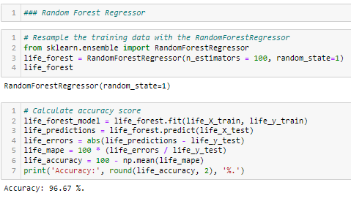
Random Forest Regressor Results
Life Expectancy
This output from Jupyter Notebook shows the accuracy of the Random Forest Regressor when predicting average life expectancy.
Commit to the Git | Final Project | Spring 2022

Slide 11
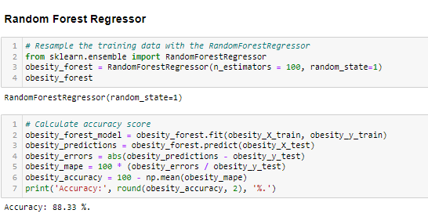
Random Forest Regressor Results
Obesity
This output from Jupyter Notebook shows the accuracy of the Random Forest Regressor when predicting obesity rates.
Commit to the Git | Final Project | Spring 2022

Slide 12
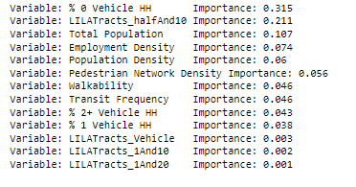
Feature Importance
Life Expectancy
This output describes the most important city features in determining life expectancy of an area's citizens.
Commit to the Git | Final Project | Spring 2022

Slide 13
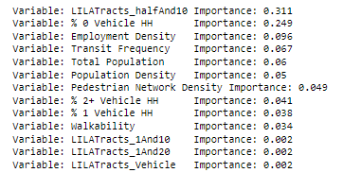
Feature Importance
Obesity
This output describes the most important city features in determining the rate of obesity in a particular area.
Commit to the Git | Final Project | Spring 2022

Slide 14
Tableau Visualizations
Model Results
Obesity
Life Expectancy
Commit to the Git | Final Project | Spring 2022

Slide 15
CONCLUSION
Our Null Hypotheses was: Census Tracts with a higher walkability score and increased access to public transit will have a lower rate of obesity and a longer life expectancy.
In the end we did see a correlation between higher walkability scores and increased access to public transit to lower rate of obesity and a longer life expectancy.
Commit to the Git | Final Project | Spring 2022

Slide 16



Github
Github collaboration can be complicated. Files need to be clean and organized on the local computer.
Data Cleaning
Data Cleaning may involve a lot of extra research. Even though it seems solitary, it may require teamwork!
Challenges
Database Administration
Using SQL meant that our database administrator needed to run everything on the local computer.
Commit to the Git | Final Project | Spring 2022

Slide 17
RECOMMENDATIONS FOR FUTURE ANALYSIS
The ranked features highlight a primary issue in cities – citizens who have the ability to own a car tend to have healthier outcomes. Future analysis of this topic would need to dive deeper into wealth disparity and how it affects citizens.
Commit to the Git | Final Project | Spring 2022

Slide 18

Commit to the Git
Thank you for your interest in our project. Please check out our github for more detailed information about our process.
Rowena Quinn
Chris Swan
Kyle Kramer
Savannah McIntyre
Charles Bolton
https://github.com/kramerkyle/FinalProject
Commit to the Git | Final Project | Spring 2022

Slide 19
Citations
Data Sources
INFRASTRUCTURE DATA
FOOD ACCESS DATA
LIFE EXPECTANCY DATA
OBESITY DATA
CENSUS TRACT DATA
Each resource is linked. Please feel free to click the links and explore our resources.
Coding Help and Research
Python: How To Convert SQL To DataFrame In Pandas
Approving a pull request with required reviews
Random Forest in Python
Understanding Geographic Identifiers (GEOIDs) (census.gov)
Commit to the Git | Final Project | Spring 2022

